Slide 1
Announcement
The LAST coding assignment, i.e., Assignment 6, is due on 12/11

Slide 2

CSC415 Operating System Principles
File System Interface
Professor Hao Yue
Fall 2017

Slide 3

Outline
Overview
Access Methods
Directory
Protection

Slide 4
Overview
A file is a named collection of related information
Logical storage unit
Programs and data
The information in a file is defined by its creator
File Attributes
Name: human-readable form
Identifier: non-human-readable name for the file in file system
Type and size
Location: Pointer to the location of the file on device
Protection: access-control information
Time, date, and user identification
File information is stored in the directory structure on the disk

Slide 5
Overview
File Operations
Create: find the space in the file system for the file and add an entry for the new file to the directory
Write: specify the name of the file and the information to be written. A write pointer is maintained to the location for next write
Read: specify the name of the file and the location to store the information read from the file. A read pointer is maintained.
Reposition: reposition the current-file-position pointer to a given value
Delete: release the file space and remove the directory entry
Other common operations include appending new information to an existing file and renaming an existing file

Slide 6
Overview
File Types
If OS can recognize the type of a file, it can operate on the file in reasonable ways
A common method to implement file types is to include the type as part of the file name
The file name contains a name and an extension, usually separated by a period
The system uses the extension to indicate the type of the file and the type of operations that can be done on the file
Application programs also use extensions to indicate file types in which they are interested

Slide 7
Directory
Directory can be viewed as a table that translate file names into their directory entries
Operations on a directory
Search for a file: search a directory structure to find the entry for a file
Create a file: create new files and add them to the directory
Delete a file: remove the file from directory
List a directory: list the entries in a directory
Rename a file: change file name and the position of the file in a directory
Traverse the file system
Different methods to define the logical structure of a directory

Slide 8
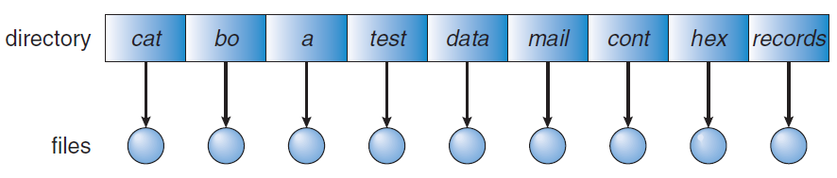
Directory
Single-Level Directory
All files are contained in the same directory
Limitations
Files must have unique names, which is hard to achieve when there is more than one user
Hard to remember the names of all files when the number of files increases

Slide 9
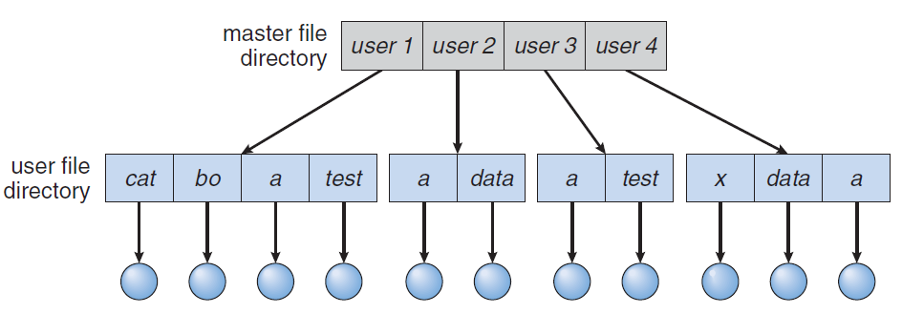
Directory
Two-Level Directory
Create a separate directory for each user
User File Directory (UFD) lists the files of a single user
Master File Directory (MFD) is indexed by user names or account number

Slide 10
Directory
Two-Level Directory
Create a separate directory for each user
User File Directory (UFD) lists the files of a single user
Master File Directory (MFD) is indexed by user names or account number
Path name: user name + file name
Advantages
Different users can have files with same name
Searching occurs in the local UFD
Limitation
Users cannot access others’ files

Slide 11
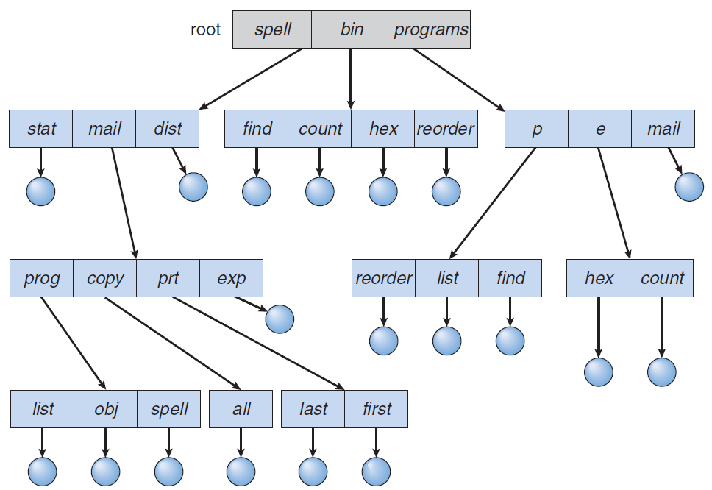
Directory
Tree-Structured Directory
A directory contains a set of files or subdirectories

Slide 12
Directory
Tree-Structured Directory
A directory contains a set of files or subdirectories
Path names: absolute and relative
Absolute path name begins at the root and follows a path down to the file
Relative path name defines a path from the current directory
Advantages
Efficient searching
Users are allowed to access the files of other users

Slide 13
File I/O API
open()
#include <sys/types.h>
#include <sys/stat.h>
#include <fcntl.h>
int open(const char *pathname, int flags, mode_t mode)
Open a file specified by pathname and return a file descriptor
flags: must include one of O_RDONLY, O_WRONLY, or O_RDWR. Can also include other flags like O_CREAT, O_EXCL
mode: must be supplied when O_CREAT is used as flag
Return the new file descriptor, or -1 if an error occurs
Example: open(file1, O_WRONLY | O_CREAT | O_EXCL, S_IRWXU)
Notes:
Ensure that this call creates the file: if this flag is specified in conjunction with O_CREAT, and pathname already exists, then open() fails with the error

Slide 14
File I/O API
close()
#include <unistd.h>
int close(int fd)
Close the file specified by the file descriptor fd
Return 0 on success. Return -1 on error.

Slide 15
System Calls
Example: read()
#include <unistd.h>
ssize_t read(int fd, void *buf, size_t count)
Read up to count bytes from the file with the descriptor fd into the buffer starting at buf
On a successful read, the number of bytes read is returned. A return value of 0 indicate end of file. If an error occurs, read() returns -1.

Slide 16
System Calls
Example: write()
#include <unistd.h>
ssize_t write(int fd, const void *buf, size_t count)
Write up to count bytes to the file with the descriptor fd from the buffer starting at buf
fd = 1 for standard out
On a successful write, the number of bytes written is returned. A return value of 0 indicate nothing is written. If an error occurs, write() returns -1.

